Slide 1
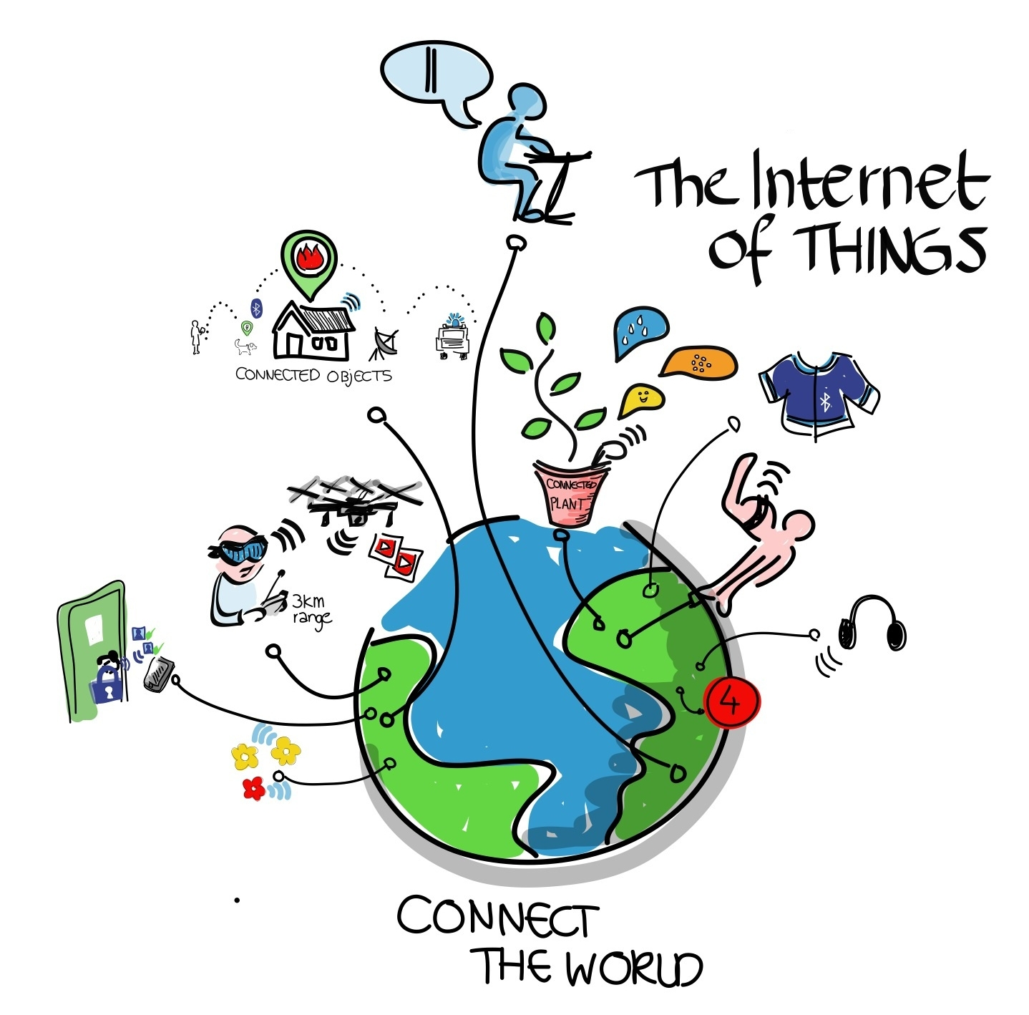

Slide 2
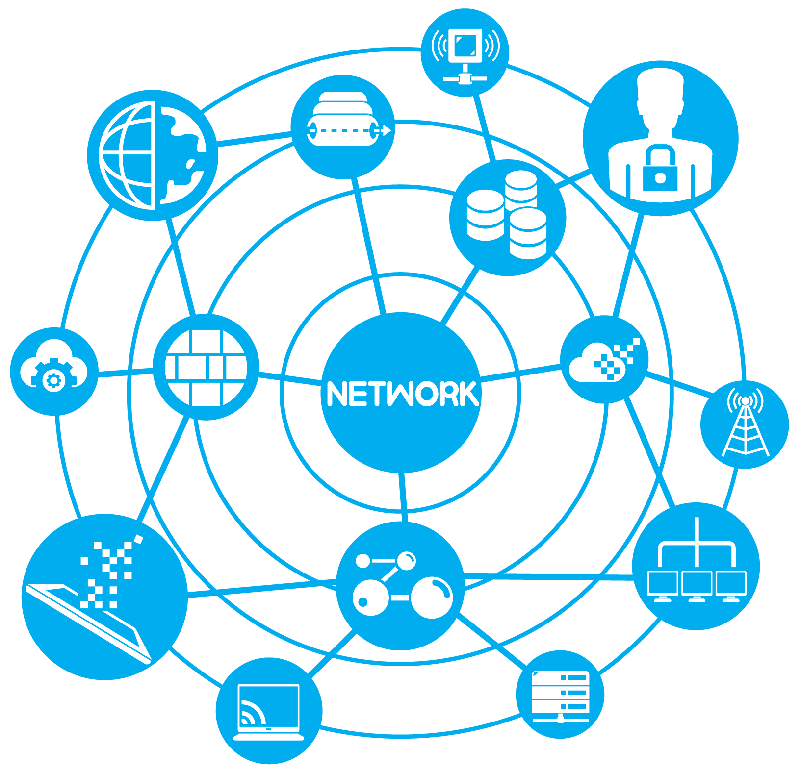

HTML

Slide 3
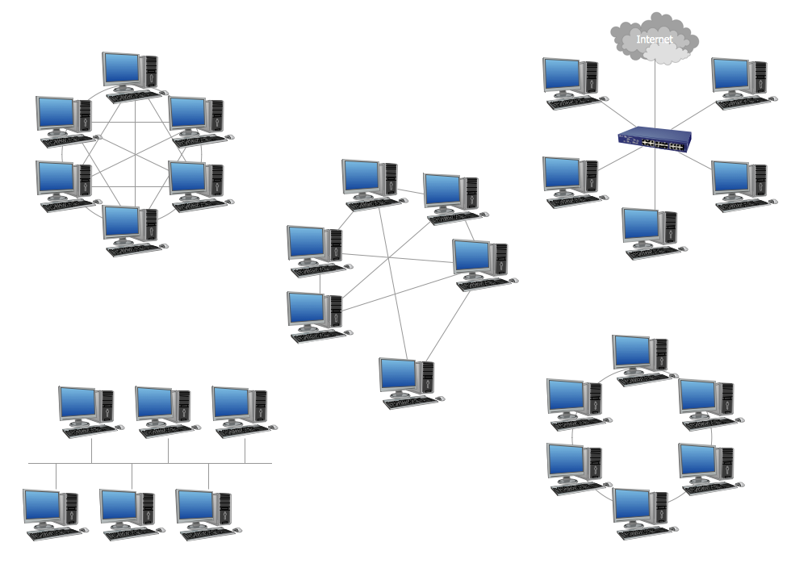
Local Network

Slide 4
Local Network – Cannot talk to other networks

Slide 5
Parts of A Network

Slide 6

Who’s Who?

Slide 7
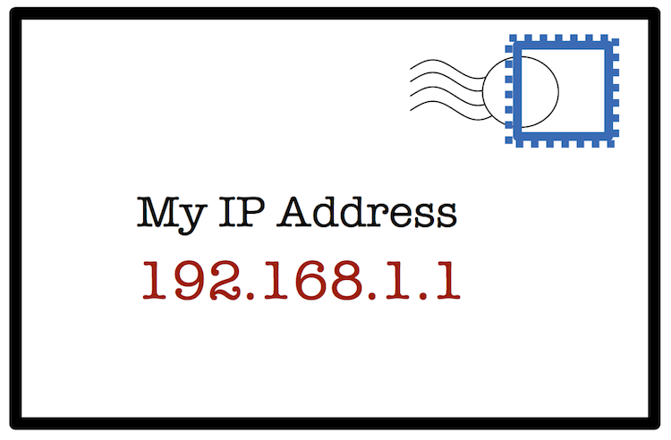
Who’s Who?

Slide 8
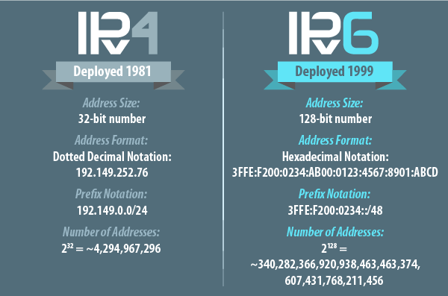

Slide 9
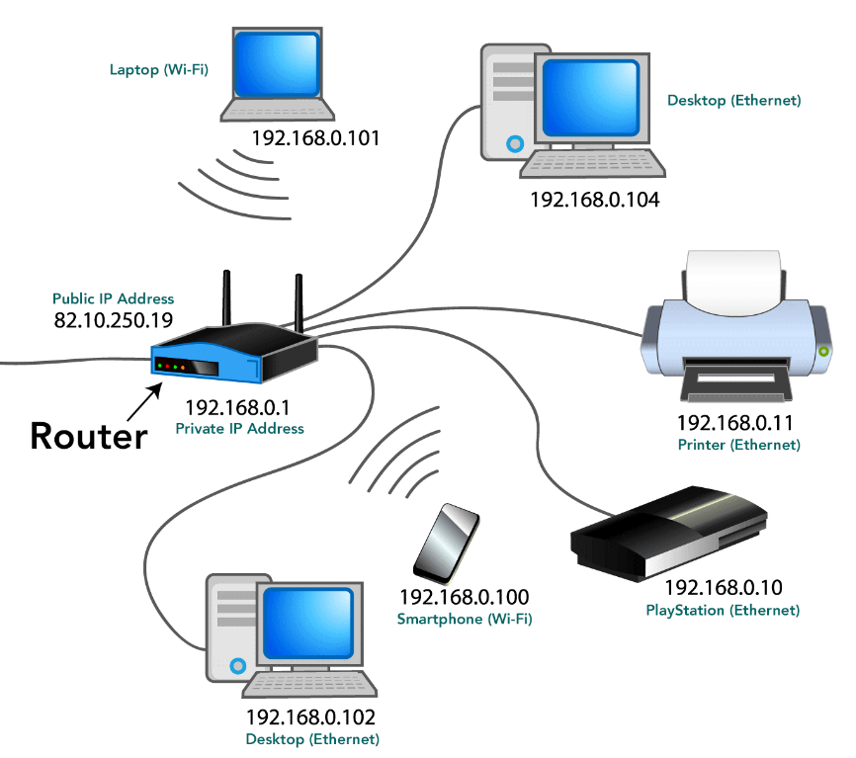
Router gives everyone a local IP address

Slide 10
Only people on your network can talk to you

Slide 11
The Router is also assigned one Public IP

Slide 12





Local IP –> 192.168.0.3
Global IP –> 173.2.464.54
Server (ESPN.com)
Global IP – 176.23.54.96
Local IP –> 192.168.0.4
Global IP –> 173.2.464.54
When the router receives information at the Global IP, it forwards it to the correct local IP
Server (Google.com)
Global IP – 142.76.84.22
Local IP –> 192.168.0.5
Global IP –> 173.2.464.54

Slide 13
Local IP –> 192.168.0.3
Global IP –> 173.2.464.54
Server (ESPN.com)
Global IP – 176.23.54.96
Local IP –> 192.168.0.4
Global IP –> 173.2.464.54
Server (Google.com)
Global IP – 142.76.84.22
Local IP –> 192.168.0.5
Global IP –> 173.2.464.54

Slide 14

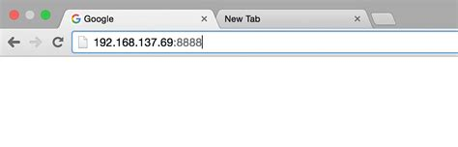
Where’s my site?
Serial.print(WiFi.localIP());
Will print the local IP of your project
You can enter that address into any browser to see your site
It will only work as long as you are on the same network as your project

