Slide 2
HTTP and HTML
HTTP – Standardize the packaging
HTML – Standardize the information
HTML
HTTP

Slide 3
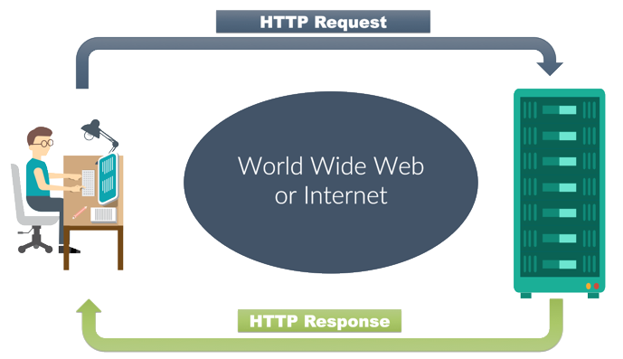
HTTP- Standardize the packaging
Stands for Hyper Text Transfer Protocol
The basis for data communication in the internet
Data communication starts with a request sent from a client, and ends with the response received from a web server

Slide 4
HTML – Standardize the information
Hypertext Markup Language (HTML) is the standard language for creating web pages.
Web browsers receive HTML code and render it into multimedia web pages
HTML elements create structure such as headings, paragraphs, lists, links, quotes and other items

Slide 5
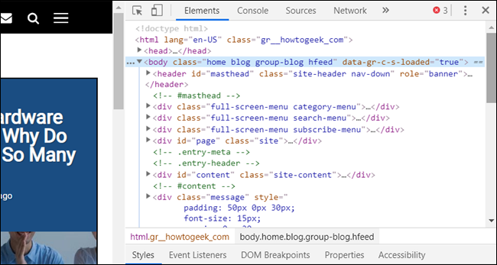

Slide 6
HTML - Where to code?

Slide 7
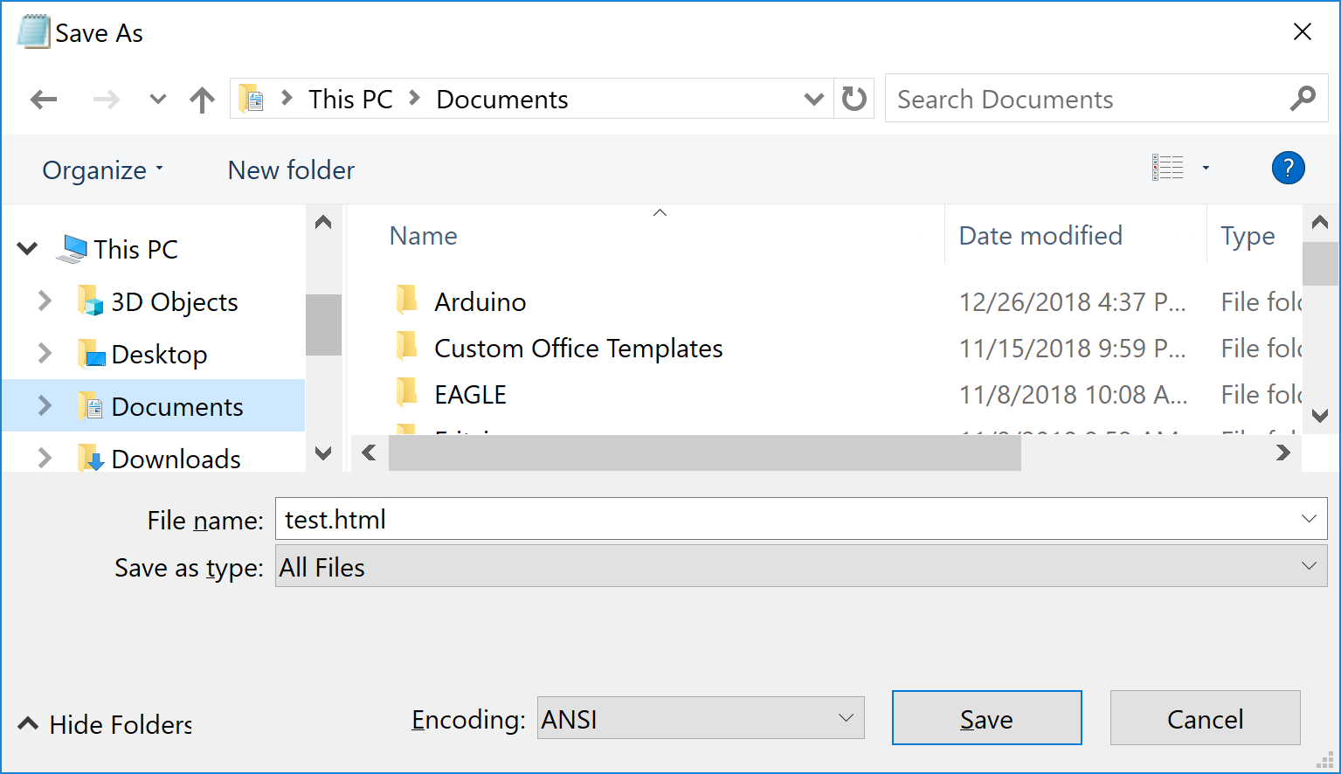
HTML - Where to code?

Slide 8
Compiler
an HTML compiler
Every Web browser
is essentially

Slide 9
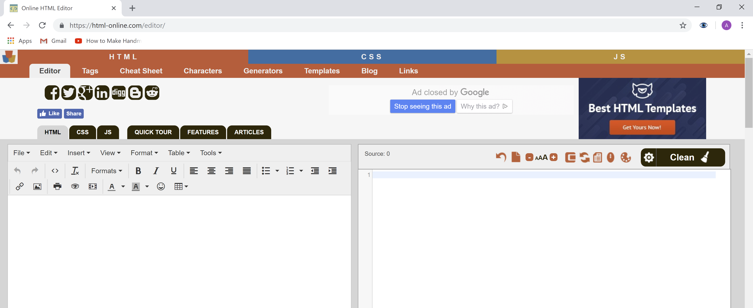
Where to code?
https://html-online.com/editor/

Slide 10
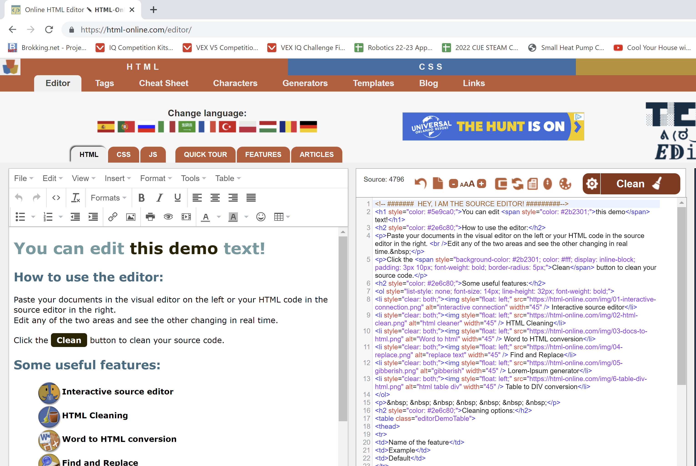

Slide 11
Tags
HTML uses Tags to mark areas of a code
Similar to { } in Arduino
A Tag is placed between < >
There is an opening
<TAG>
and closing tag
</TAG>

Slide 12
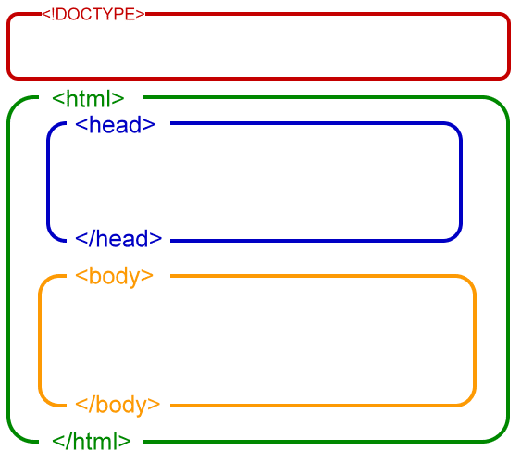
Code Structure
The first section has information indicating the type of code
Within the <html> section there is a <head> section and a <body> section
Each section closes with a closing tag.

Slide 13
Code Structure
The <head> section will contain information about your webpage
The <body> section will contain the actual webpage

Slide 14
Code Structure

Slide 15
HTML Code Structure
The <title> section contains the name of the webpage as it appears in a browser

Slide 16
HTML Code Structure
<html>
<head>
<title> Center for Initiatives in Jewish Education </title>
</head>
<body>
</body>
</html>

Slide 17
HTML Body Text

Slide 18
HTML Links

Slide 19
HTML Links

Slide 20
HTML Summary

Slide 21
Display Button State on Website
When using the Arduino IDE, All HTML coding must be within a client.println(“ ”); command
int sensorReading = analogRead(A0);
client.println("analog input is");
client.println(sensorReading);

Slide 22
Display Button State on Website

